Slide 1
Employee Data Analysis using Excel
STUDENT NAME: S. DEVA DARSHINI
REGISTER NO: 312216158
DEPARTMENT:B.COM- BANK MANAGEMENT
COLLEGE : SHRI SHANKARLAL SUNDARBAI SHASUN JAIN COLLEGE.

Slide 2
PROJECT TITLE
Employee Performance Analysis using Excel

Slide 3


AGENDA
Problem Statement
Project Overview
End Users
Our Solution and Proposition
Dataset Description
Modelling Approach
Results and Discussion
Conclusion
3/21/2024 Annual Review

Slide 4

PROBLEM STATEMENT
Goal of this project is to analyze employees data to uncover trends, disparities, and patterns that can inform decision-making for both employers and employees.

Slide 5

PROJECT OVERVIEW
Employee data analysis means analysing the
Employees data using excel by
Categorizing them by name , gender, employee unit
Performances etc
.

Slide 6
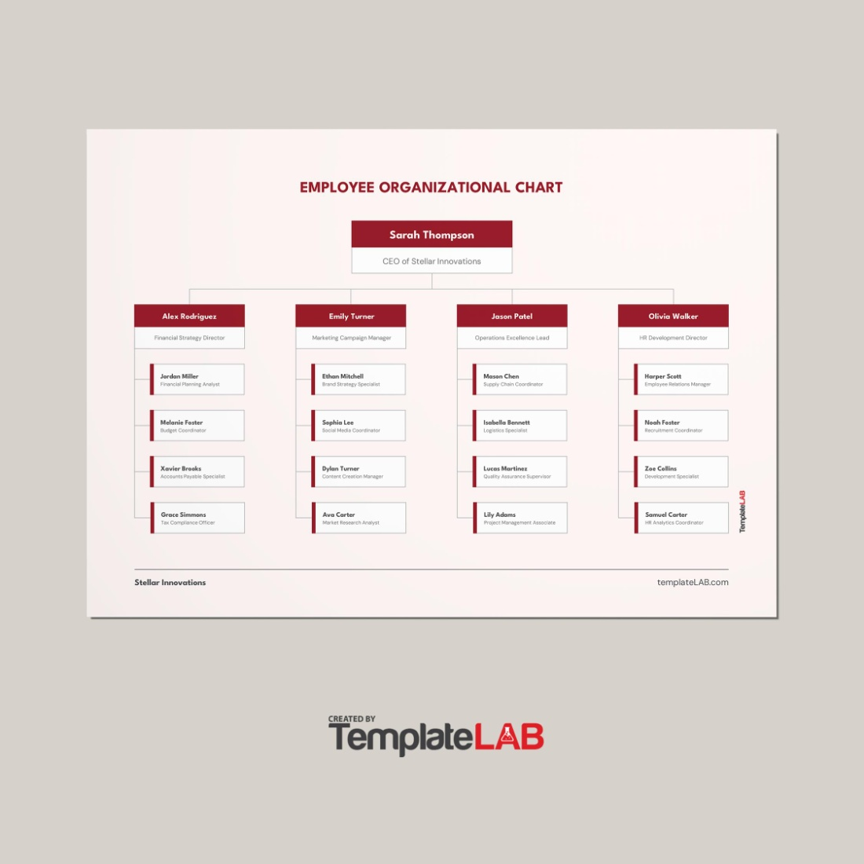
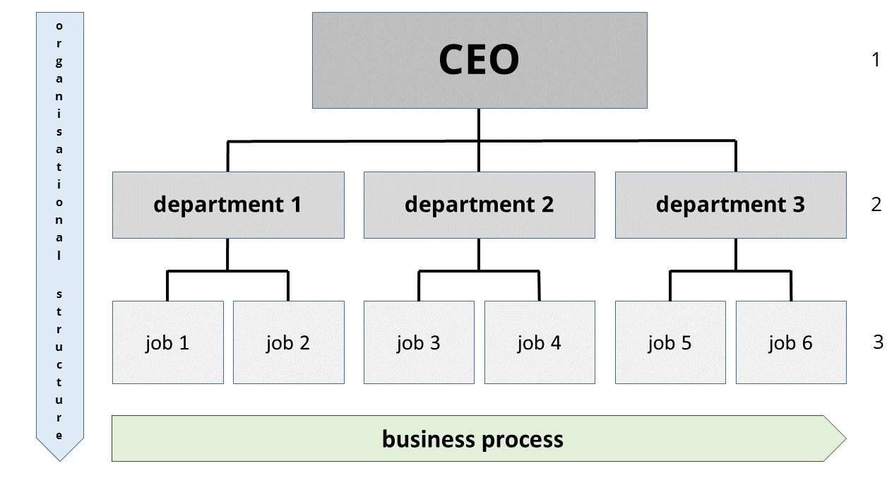

WHO ARE THE END USERS?

Slide 7

OUR SOLUTION AND ITS VALUE PROPOSITION
Conditional formatting - missing
Filter – remove
Formula - performance
Pivot table - summary
Graph – data visualization

Slide 8
Dataset Description
KAGGLE
9 FEATURES
EMPLOYER ID
NUMERICAL VALUE
NAME
PERFORMANCE LEVEL
GENDER – MALE / FEMALE
EMPLOYEE RATING

Slide 9

THE "WOW" IN OUR SOLUTION
* Performance level = IFS(Z8>=5,”VERY HIGH”,Z8>=4,”HIGH”,Z8>=3,”MED”,TRUE,”LOW”)
3/21/2024 Annual Review
9

Slide 10
MODELLING
DATA COLLECTION
FEATURE COLLECTION
DATA CLEANING
PERFORMANCE LEVEL
SUMMARY
10

Slide 11
RESULTS
11

Slide 12
conclusion
We have concluded the employee data using excel.
We have seen how to fetch and where to gather data
And also how to create pivot table and also alligned
The employees datas.
Thank you!!

